Slide 1

PHP Programming RealEstae Website
Scrip By : MHIRA Hana , MJ Hadi
November 2017

Slide 2
Common Features of Realestate website
Admin Management
-- Manage Properties (House, Apartment, Store)
-- Manage Customer( Buyer/Seller)
-- View feedback
-- Upload Pictures, News, ...
-- Reporting
Customer( Buyer / Seller) Management
-- Register and Login to System
-- Manage profile
-- View Property
-- Send Request and Feedback

Slide 3
List of Links
/user/register
/user/login
/user/socialLogin( Facebook,Gmail, LinkedIn)
/user/logout
/user/passrest
/isemailregistered/:email
/property/addedit
/property/delete - Only Admin able to do it
/property/list
/property/serch by price or Location
/news/addedit

Slide 4
List of Links
/news/delete
/news/list
/message/addedit
/message/delete – Only Admin able to do it
/message/list
/photo/addedit
/photo/delete – Only Admin able to do it
/photo/list

Slide 5
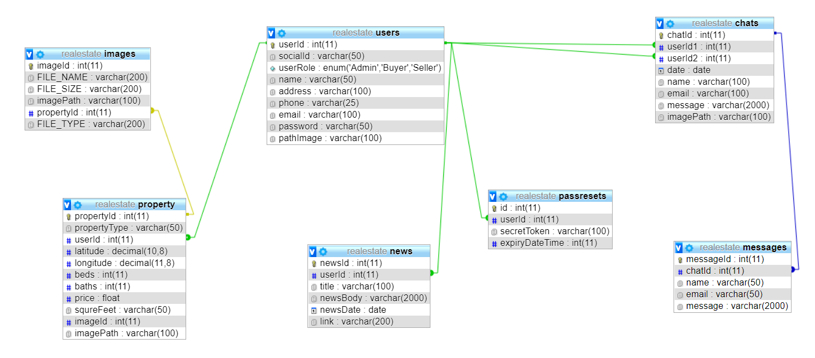
Database Diagram

Slide 6
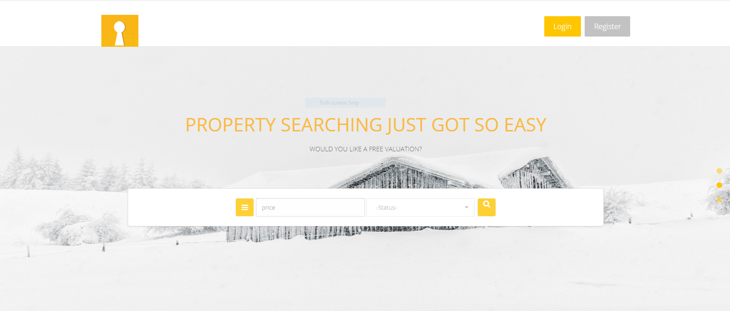
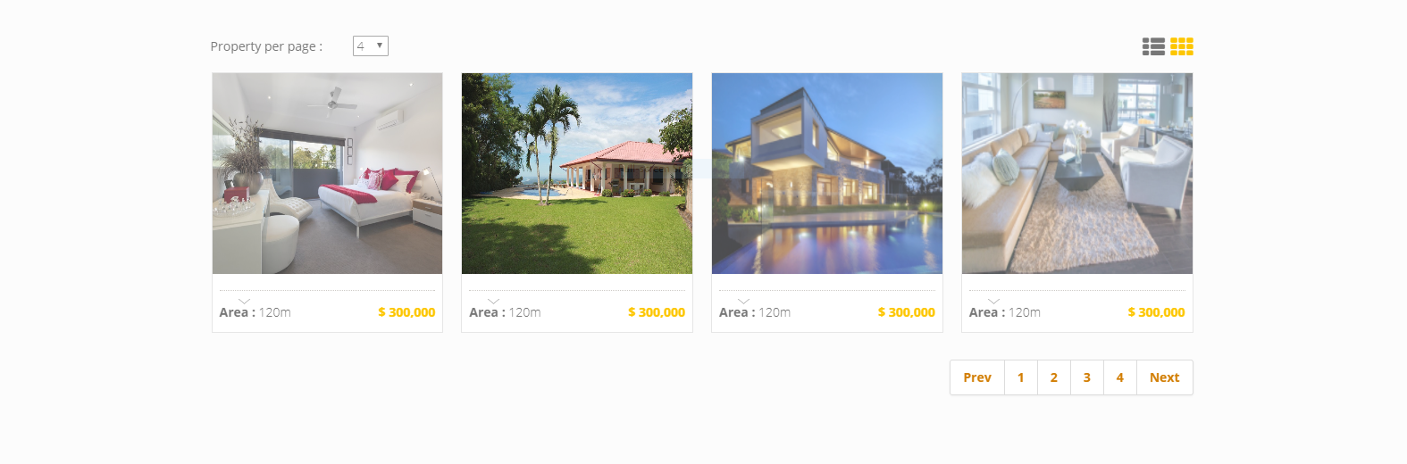
Background of Project

Slide 7
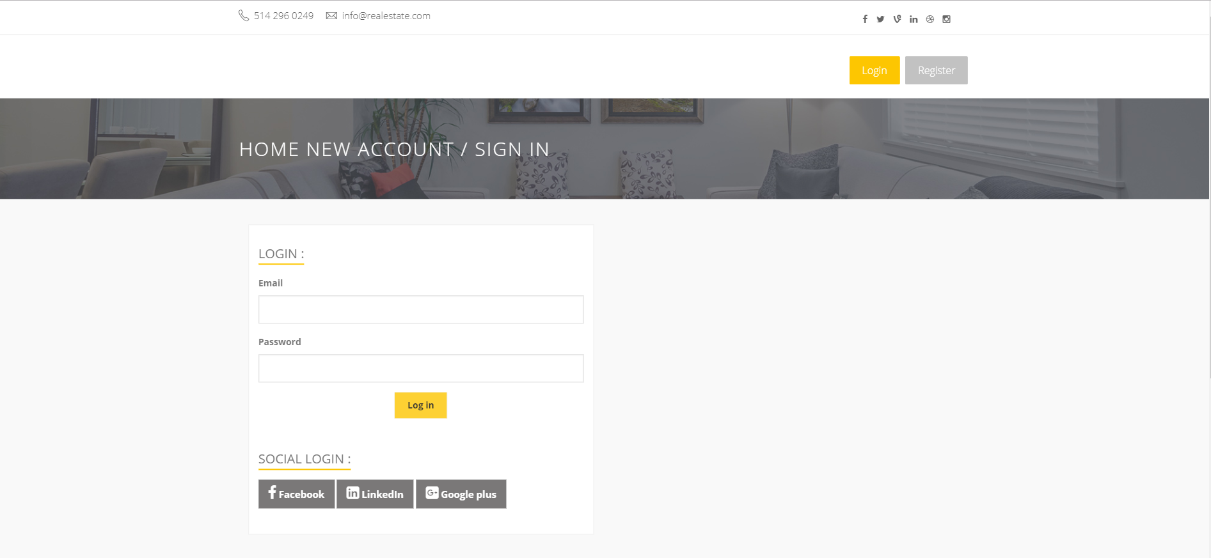
List Of Main Features
- Login Page

Slide 8
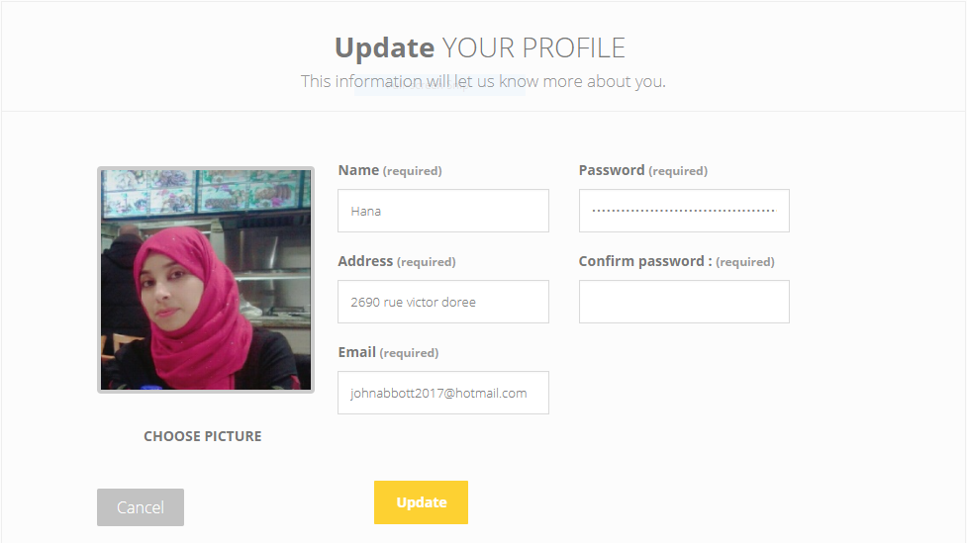
List Of Main Features
- Update Profile

Slide 9
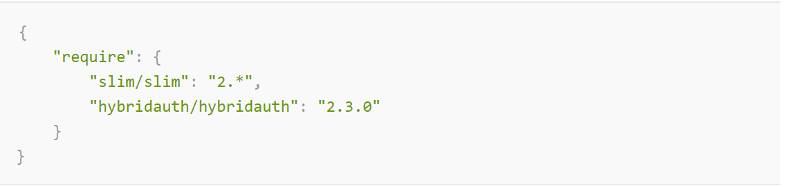
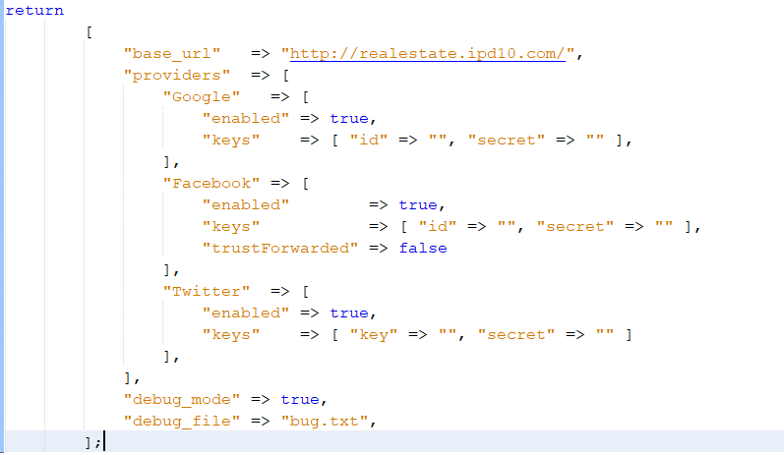
List Of Main Features
Social Login
1- Add Hybridauth library via composer-
Open source social login php library.
2- Get the client ID and secret Code
https://console.developers.google.com
https://developers.facebook.com
3- Create config php file and
put our ID and secret code

Slide 10
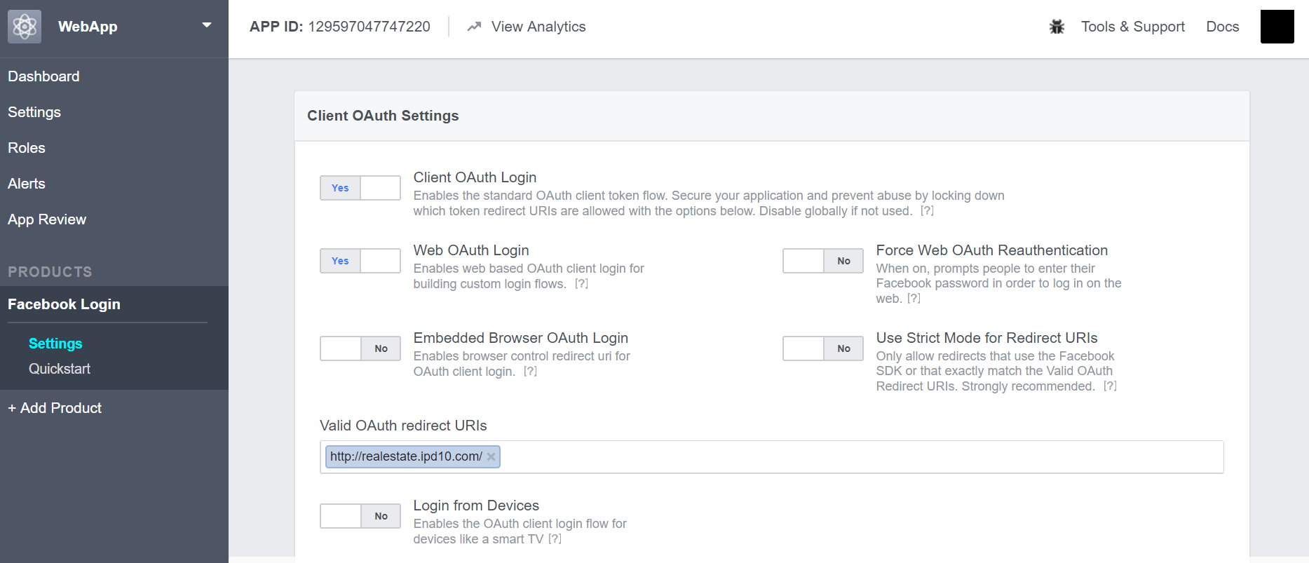
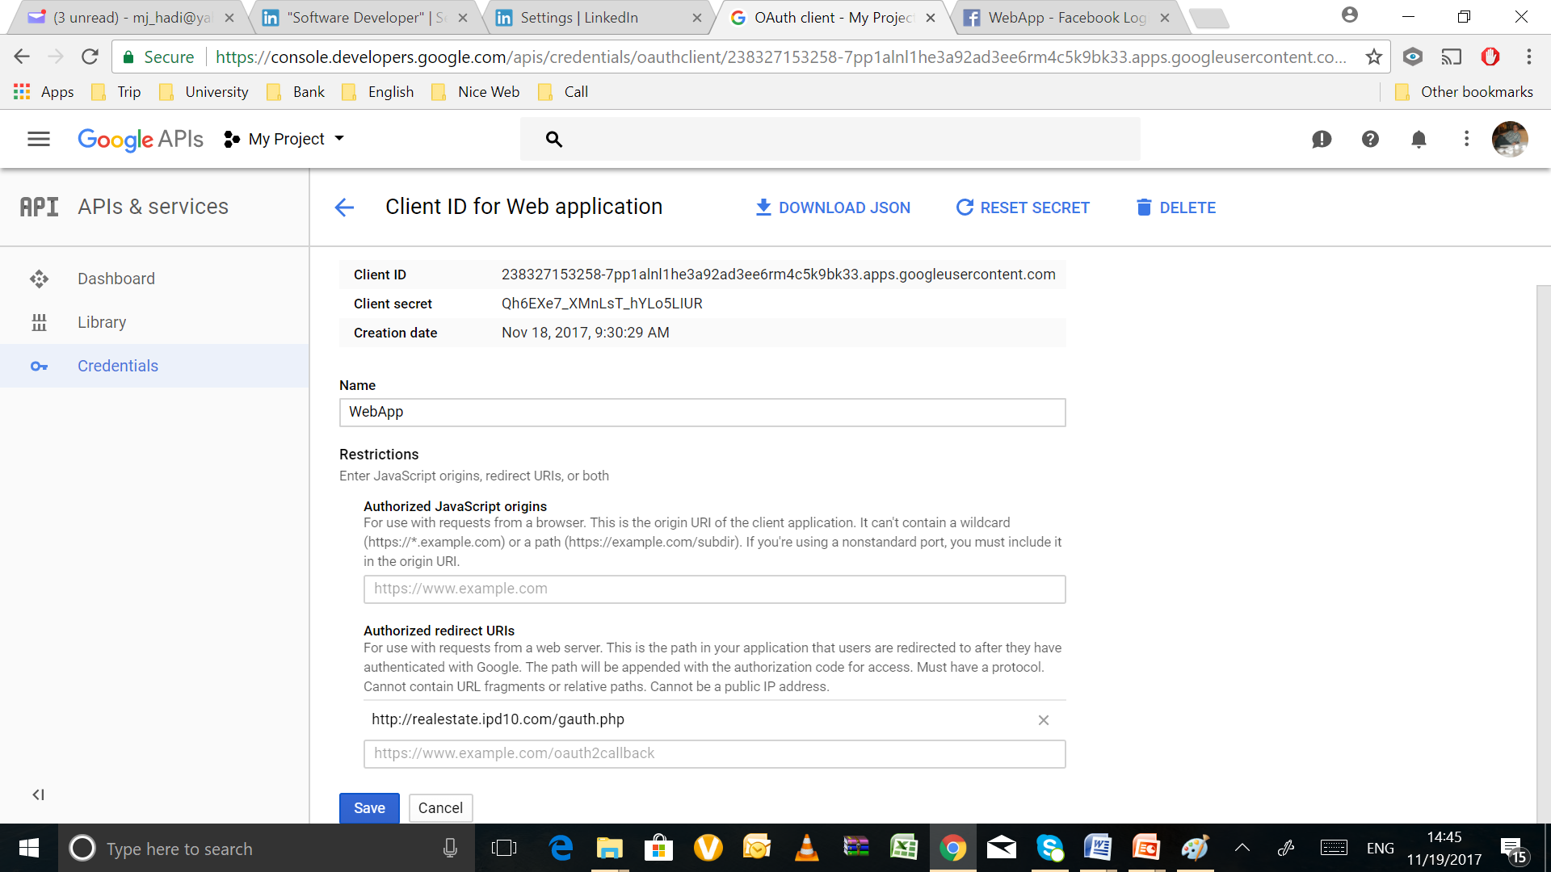
List Of Main Features
Social Login
4- CallBack Setting

Slide 11
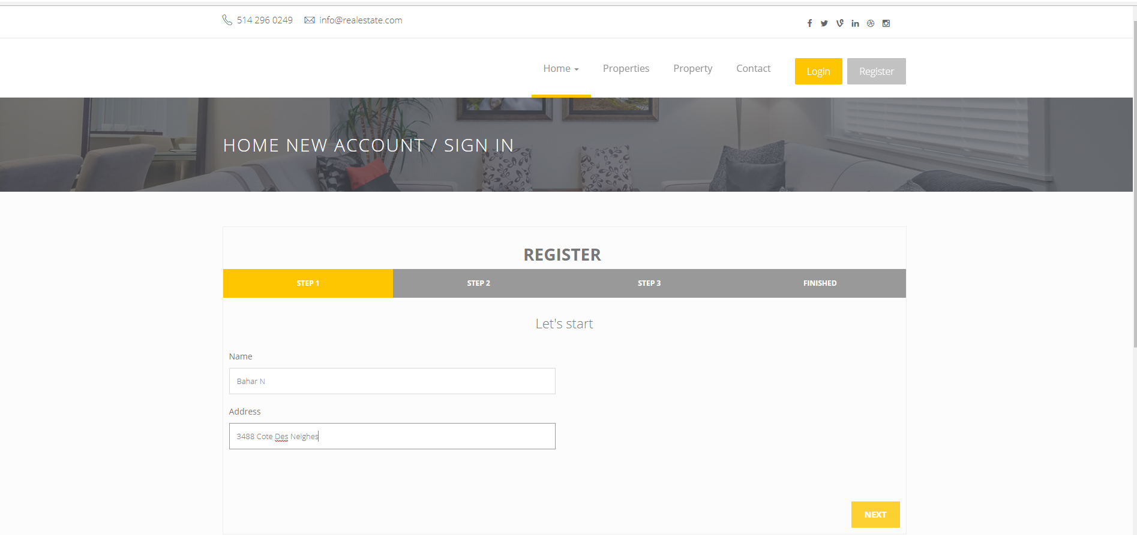
List Of Main Features
- Registration Page

Slide 12
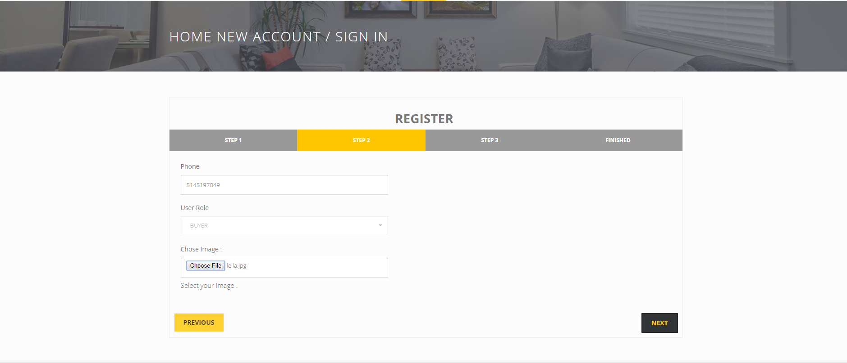
List Of Main Features
- Registration Page

Slide 13
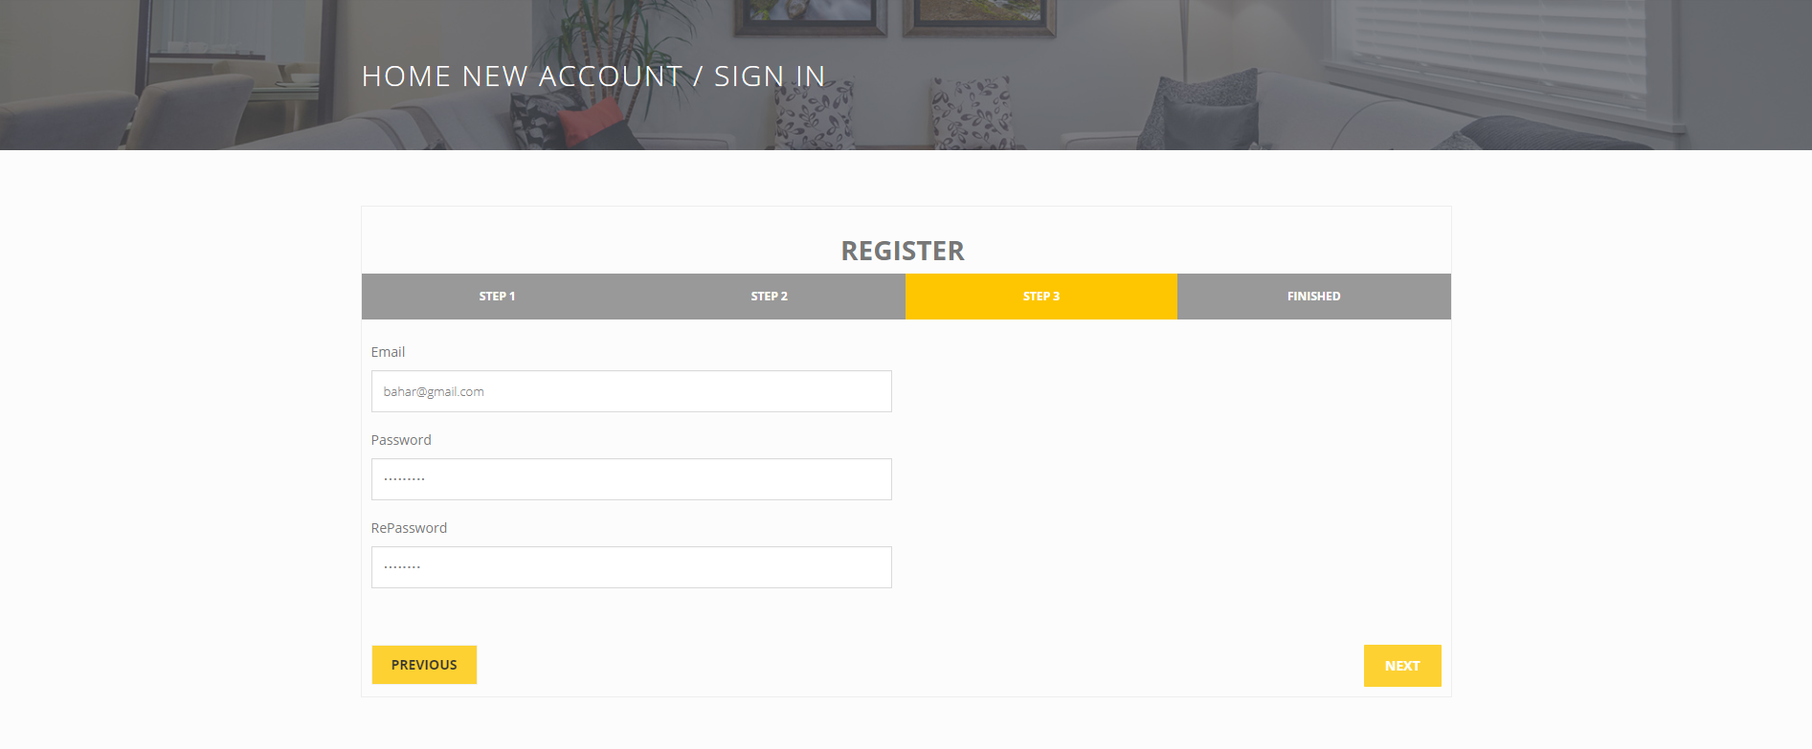
List Of Main Features
- Registration Page

Slide 14
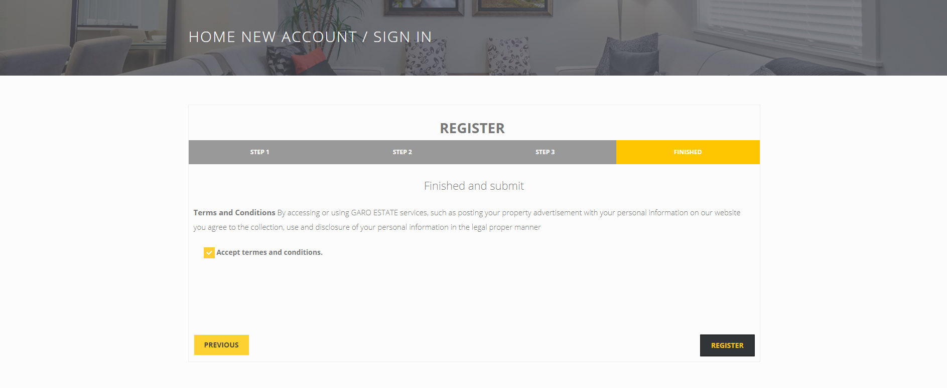
List Of Main Features
- Registration Page

Slide 15
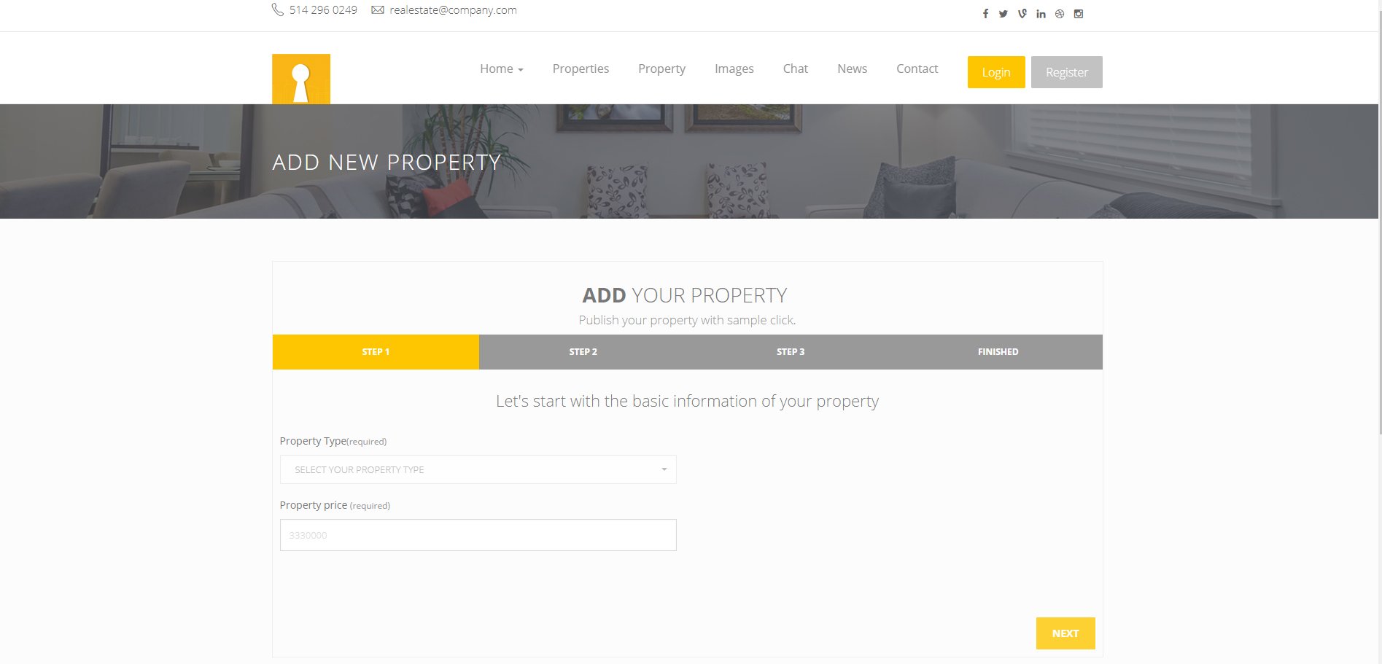
List Of Main Features
- Property/add

Slide 16
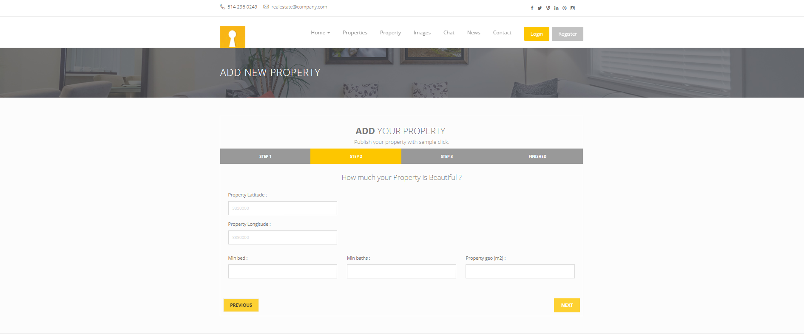
List Of Main Features
- Property/add

Slide 17
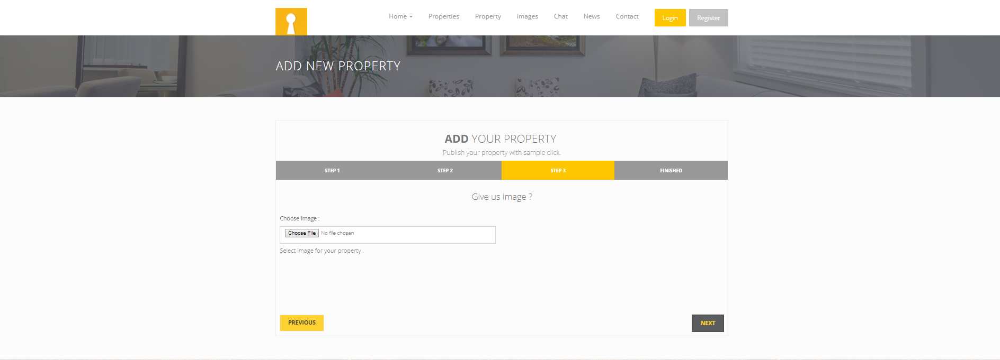
List Of Main Features
- Property/add

Slide 18
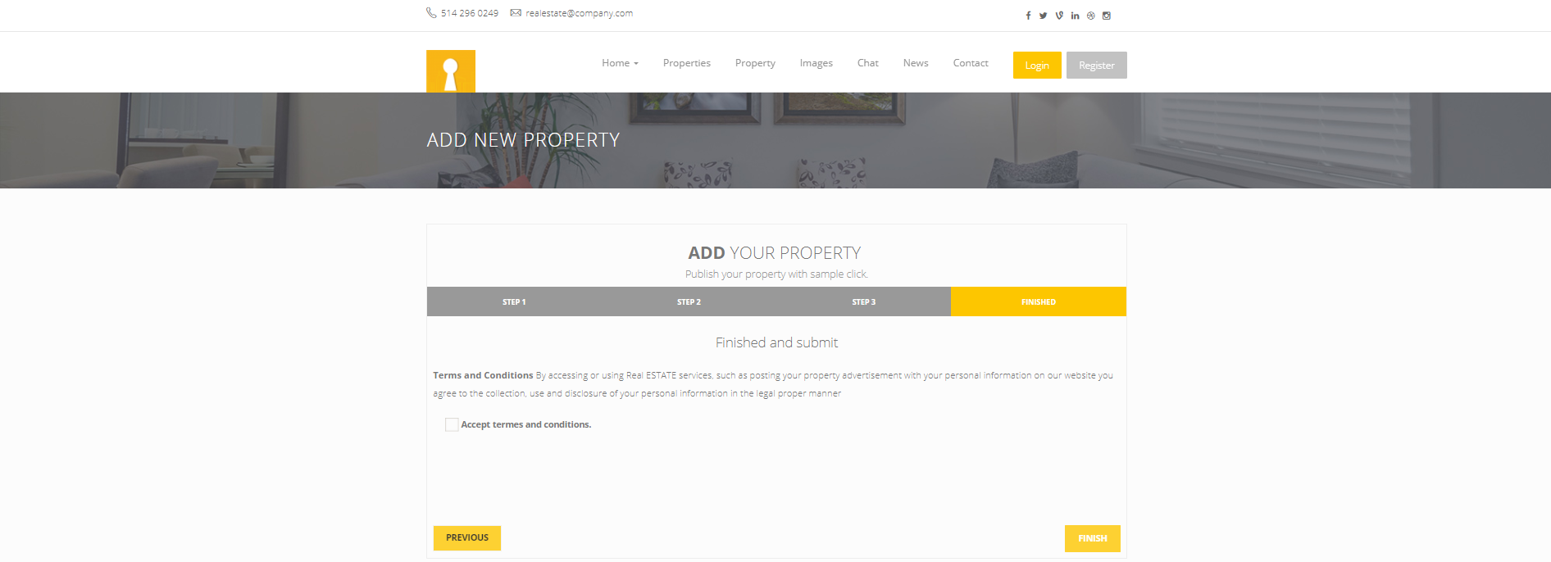
List Of Main Features
- Property/add

Slide 19
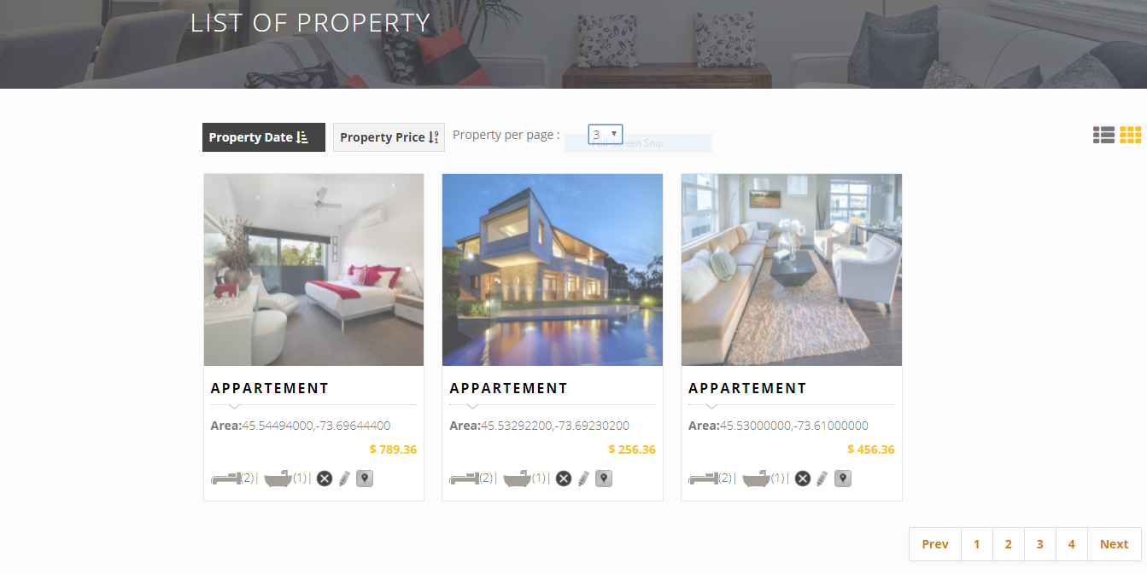
List Of Main Features
- Property/list

Slide 20
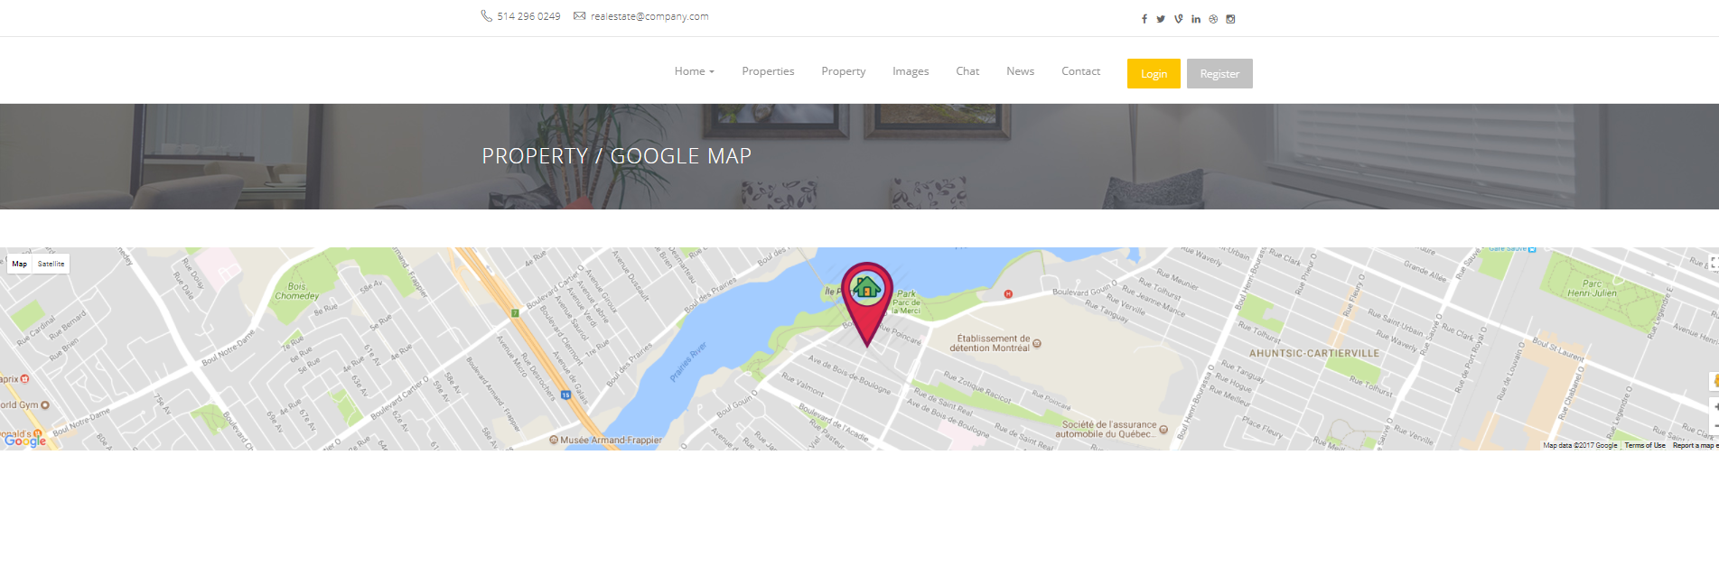
List Of Main Features
- Property-Google Map

Slide 21
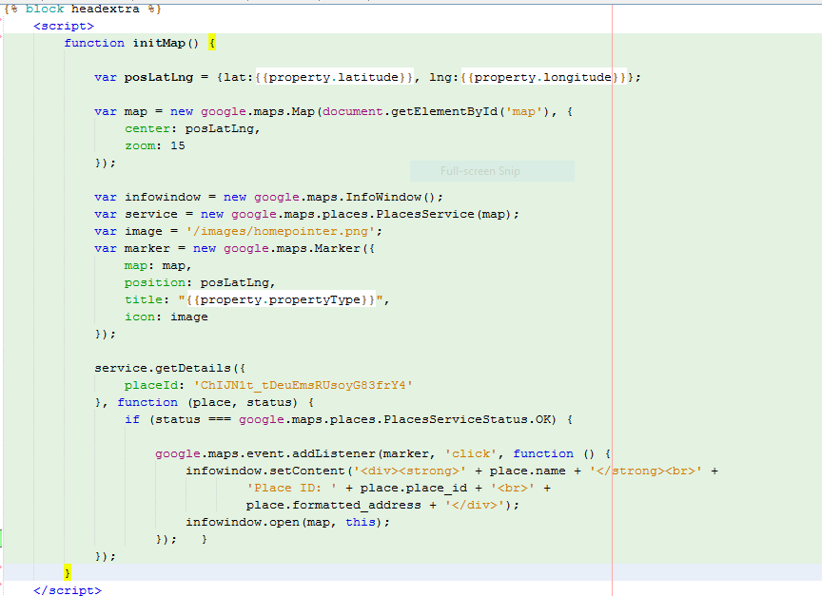
List Of Main Features
- Google Map-Code Behind

Slide 22
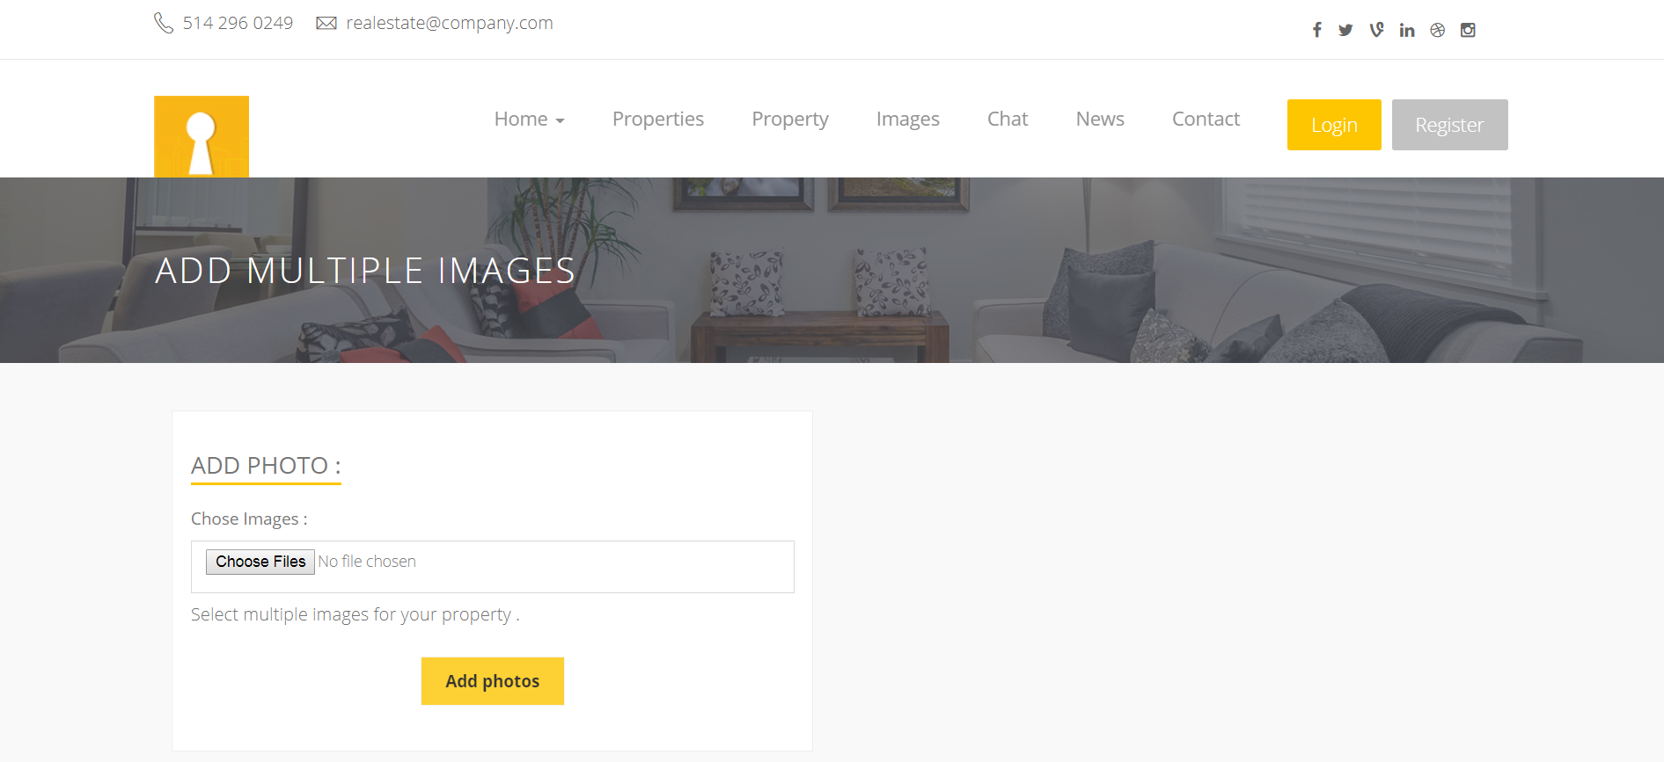
List Of Main Features
- Photo/add

Slide 23
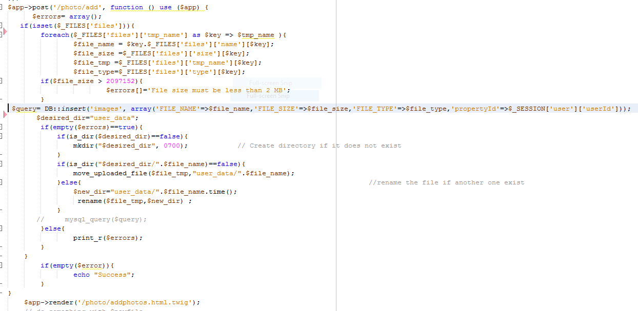
List Of Main Features
- Photo/add

Slide 24
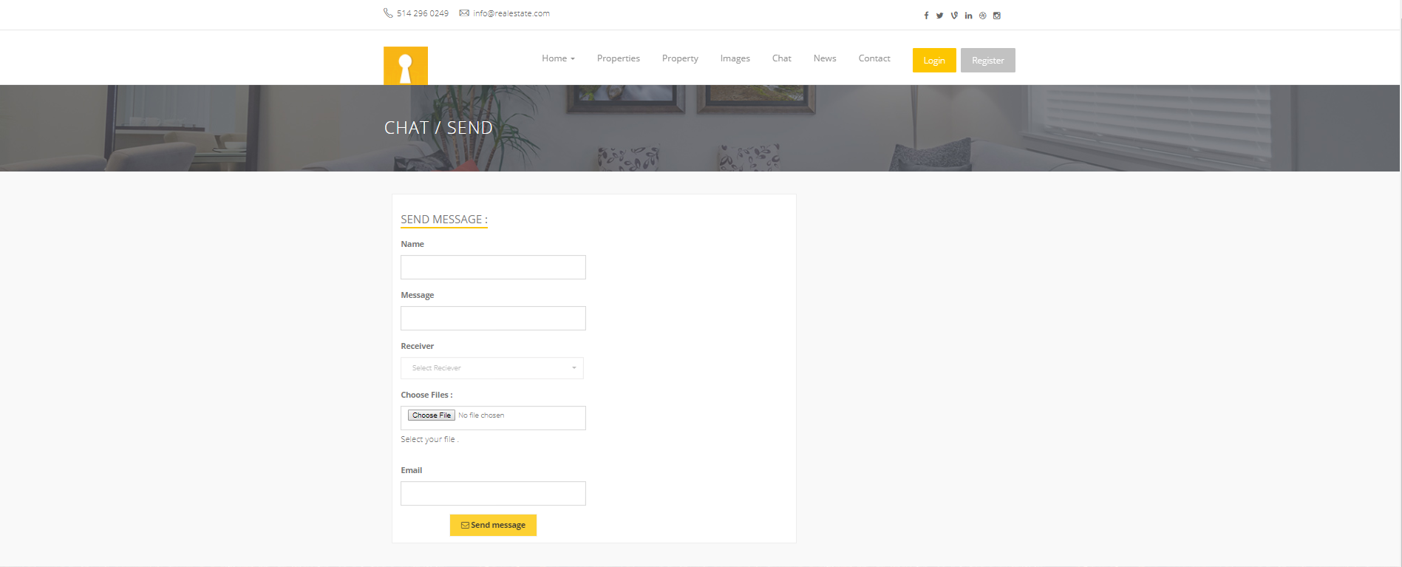
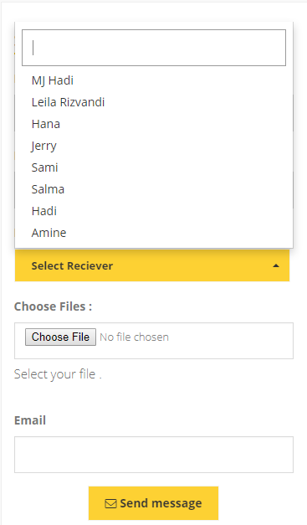
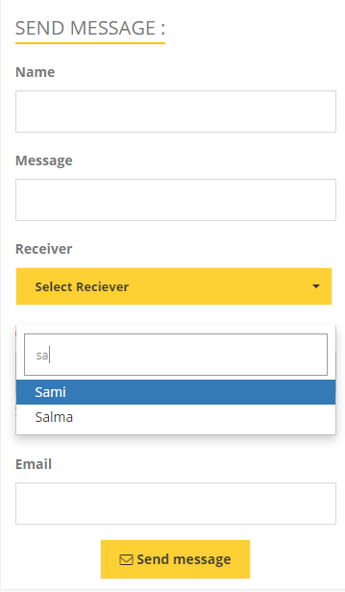
List Of Main Features
- Chat

Slide 25
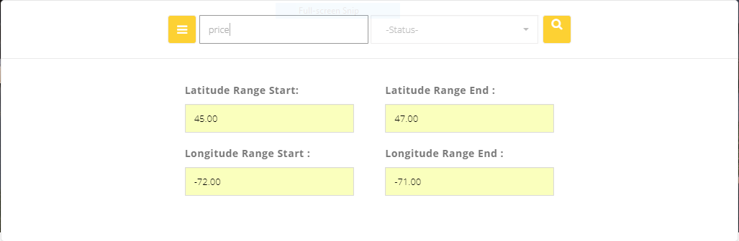
List Of Main Features
- Property/serach

Slide 26
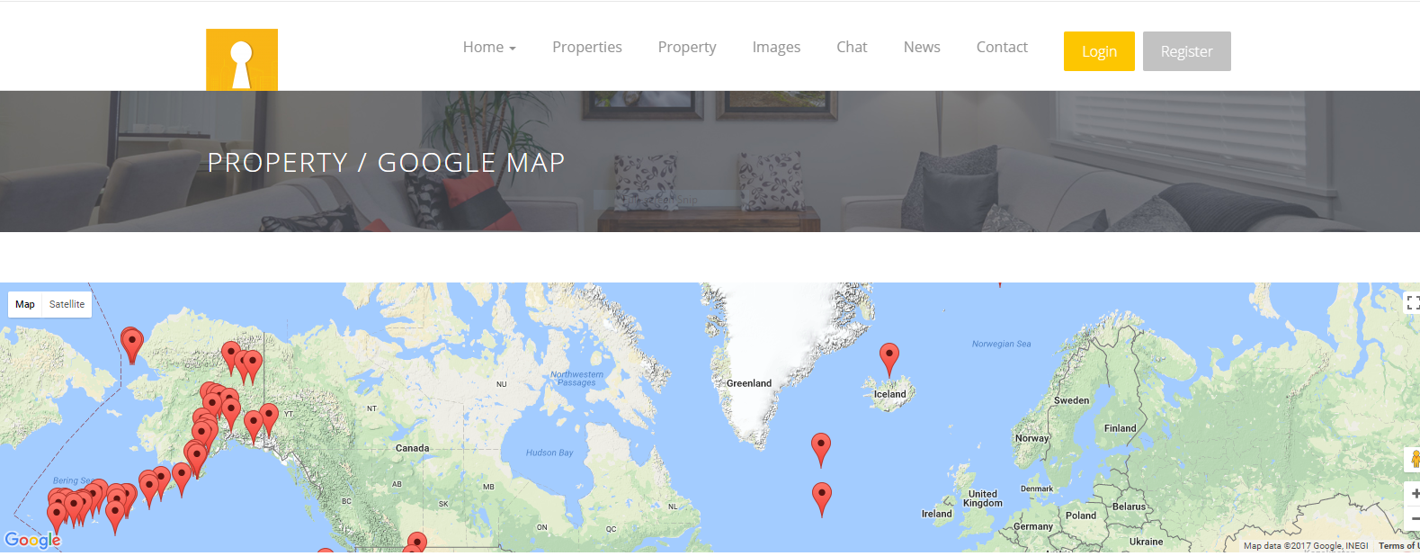
List Of Main Features
- Property/serach

Slide 27
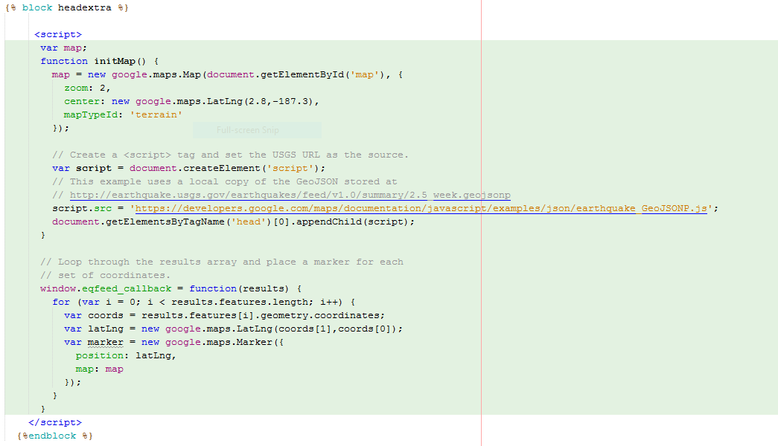
List Of Main Features
- Property/serach-Code Behind

Slide 28
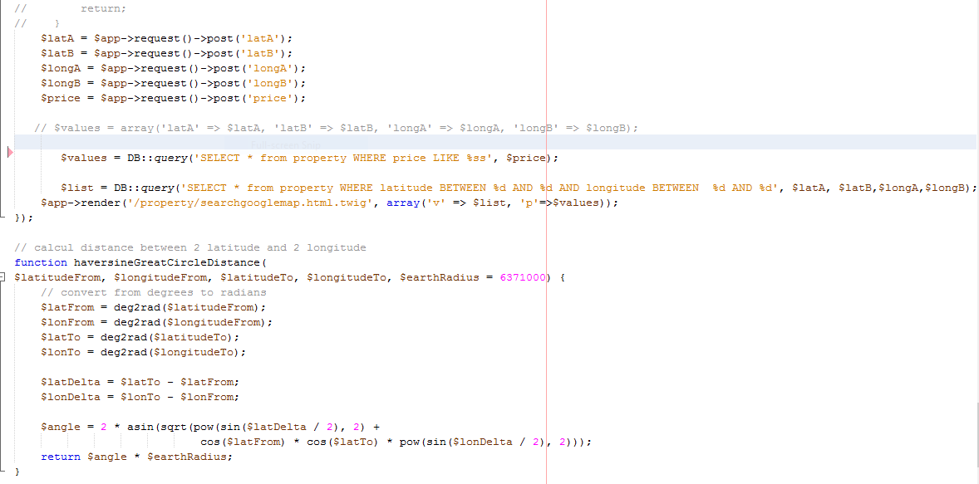
List Of Main Features
- Property/serach-Code Behind

Slide 29
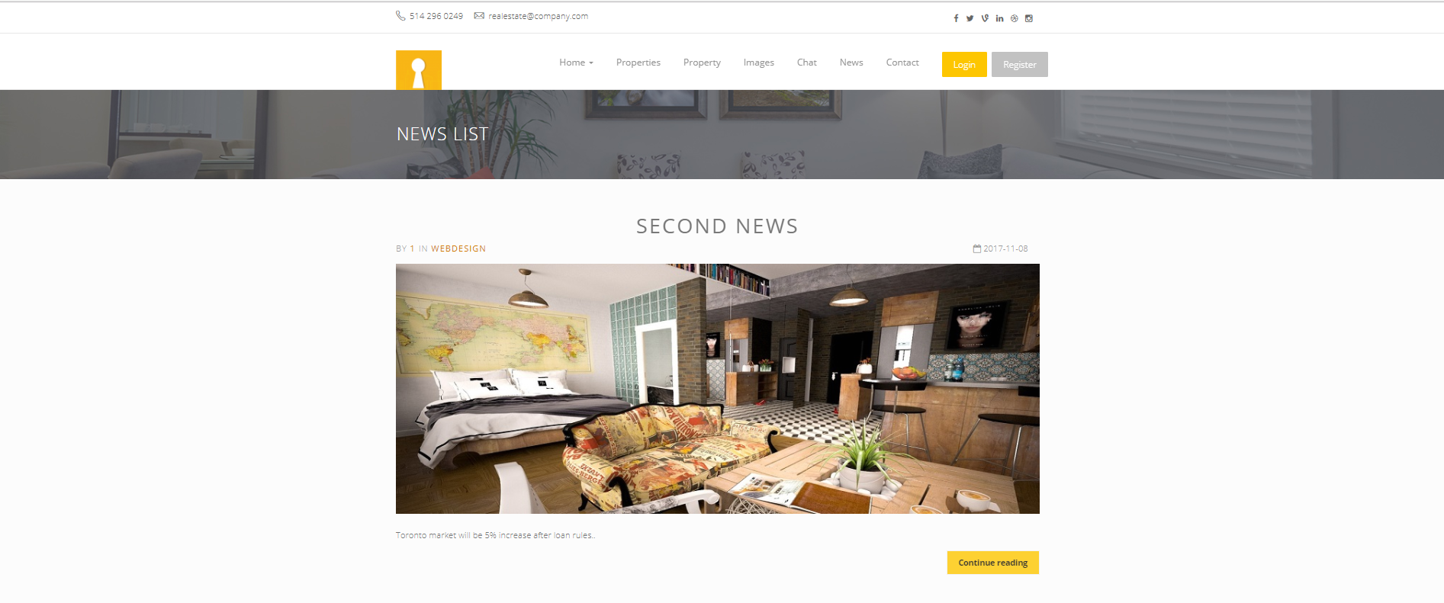
List Of Main Features
- news/List

Slide 30
Challenges and Solutions – what we learned
Login with Social Network.
Update Profile by user.
See the location of property by using GoogleMap.
Add and upload multiple images.
Autocomplete dropdownList with Ajax.
Using Boostrap with slim and twig.
Using Array File to choose multiple image.

Slide 31
Future Work

Slide 32
Thank You For Your Attention
Questions ???

